Slide 1


Group Members :
Anantha Krishnan M
Amal Raj E
Haripriya H
Veena Subramanion
Submitted By
Group –A

Slide 2


Theory vs practical
Outdated learning & exam culture

Slide 3


SITUATION AFTER PLACEMENTS

Slide 4

Why 80% of India's engineers remain unemployable in the software sector?

Slide 5


THE GREAT ESCAPE
According to our survey,90% of students prefer to go for teaching field rather than to be an engineer.
They would like to repeat the same old theories again & again rather than taking an advance topic.

Slide 6
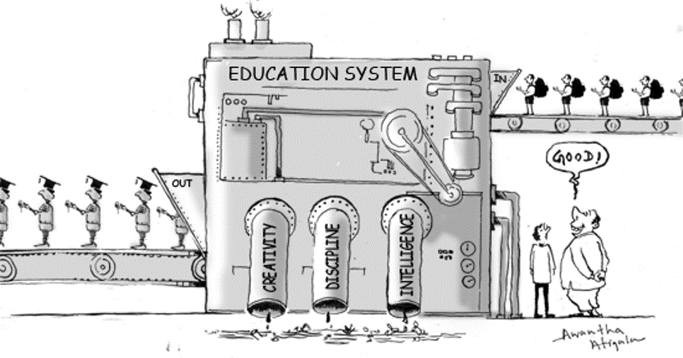
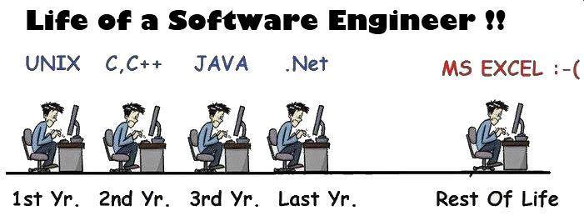
RESULT OF CURRENT EDUCATION SYSTEM

Slide 7

BTECH IN
Computer Science & Engineering(CSE) ?
or
Computer Science (CS) ?

Slide 8
REVOLUTION STARTS NOW!!!!!!!

Slide 9


 | HOME | PROJECTS | TUTORIALS | EVENTS
SEARCH..
Email id..
Password….
Login
Signup

Slide 10
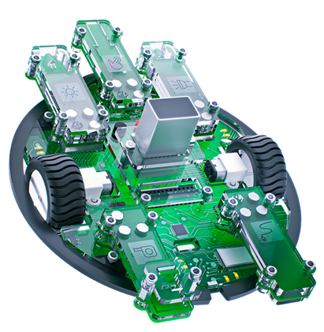


 | HOME | PROJECTS | TUTORIALS | EVENTS
SEARCH..
TUTORIALS
Introduction to
Ethical Hacking
How to protect Your App
Programming robots
in scratch

Slide 11
 | HOME | PROJECTS | TUTORIALS | EVENTS
Ethical hacking and ethical hacker are terms used to describe hacking performed by a company or individual to help identify potential threats on a computer or network. An ethical hacker attempts to bypass system security and search for any weak points that could be exploited by malicious hackers. This information is then used by the organization to improve the system security, in an effort to minimize or eliminate any potential attacks.
SEARCH..
Introduction to Ethical Hacking

Slide 12
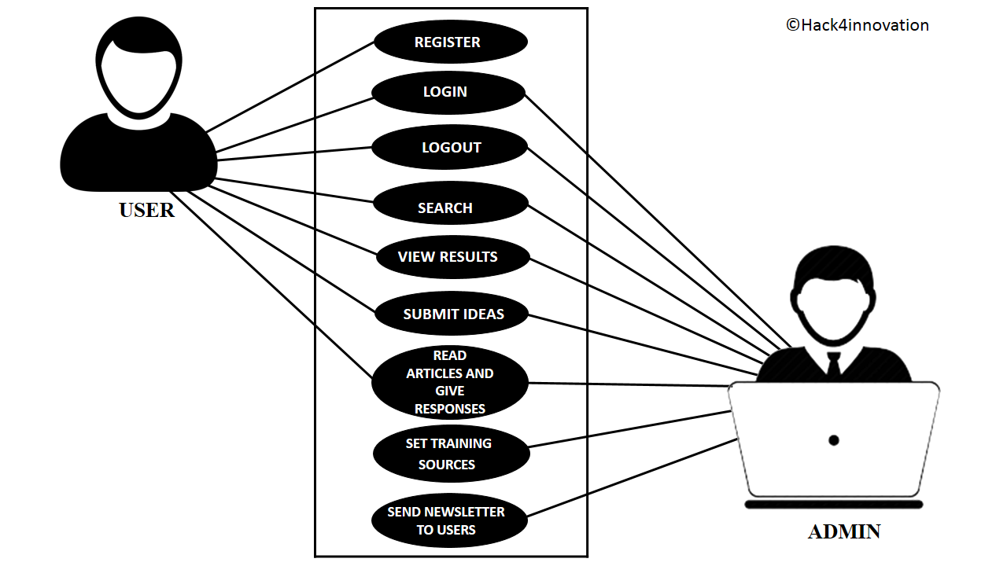
USE CASE DIAGRAM

Slide 13
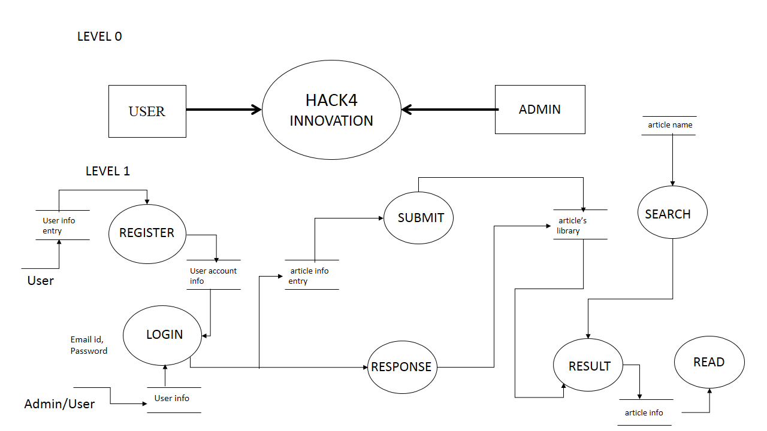
Data Flow Diagram

Slide 14
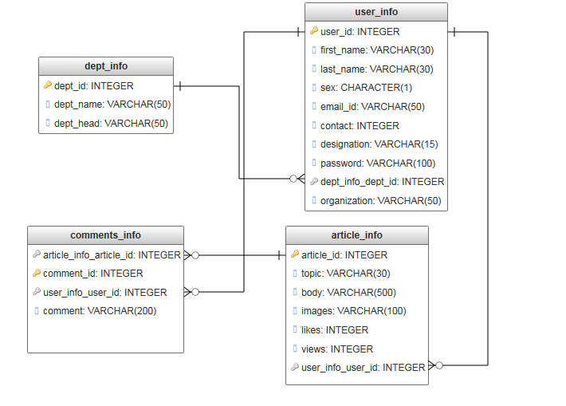
The Relational Model

Slide 15
System
database
Customer
System
System
Admin
Verify login
Verify login
Enter login info
Enter login info
Registered or
Non - registered
Login Validated
Login
Login
Send Newsletter
Search
Register
Search
Submit an idea
Submit an idea
Set training sources
Logout
Fetch articles
Logout
Fetch articles
Give responses
Give responses
SEQUENCE DIAGRAM

Slide 16

ADWAITH4 SOLUTIONS THANKS YOU…

